Slide 1
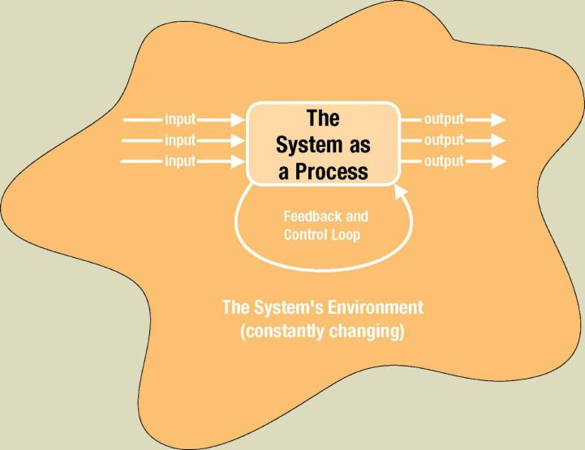
System as a Black Box (IPO)
Process
Inputs
Outputs
Notes:
No additional notes.

Slide 2
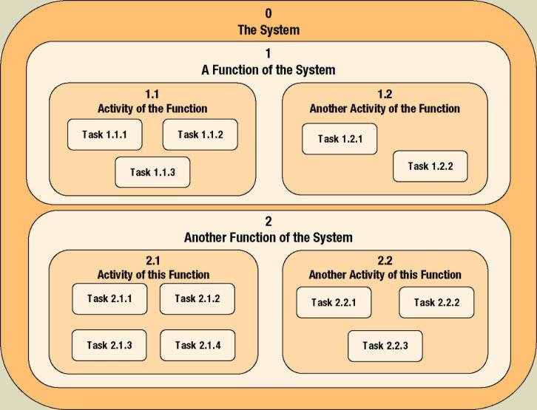
Process Decomposition
Decomposition – the act of breaking a system into sub-components. Each level of abstraction reveals more or less detail.
Notes:
No additional notes

Slide 3
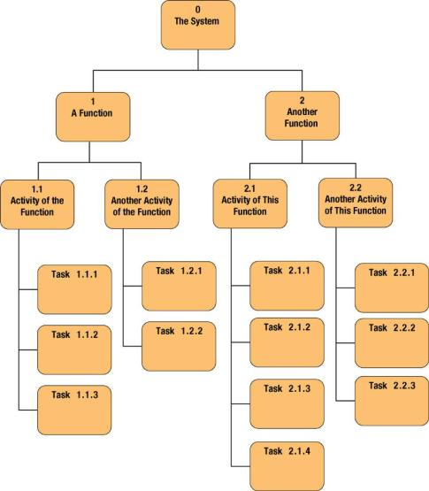
Decomposition Diagrams
Decomposition diagram – a tool used to depict the decomposition of a system. Also called hierarchy chart.
Notes:
Teaching Notes
Decomposition is a top-down problem-solving approach.
It might be useful to point out the numbering scheme. This scheme is common, but we do not like it because if the system is restructured, it forces renumbering all processes.
Some instructors like to do a quick example using a small but realistic problem.

Slide 4
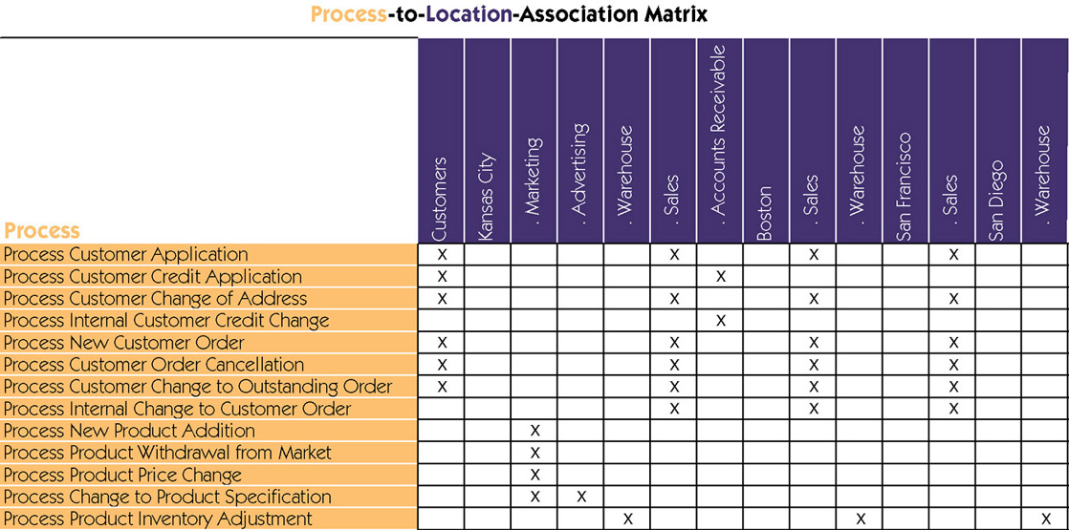
Process Distribution
Notes:
No additional notes.

Slide 5
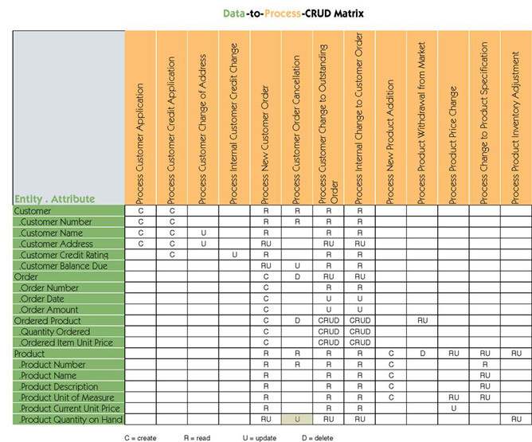
Data & Process Model Synchronization CRUD Matrix
Entities,
Attributes
Processes
CRUD
Notes:
No additional notes.

Slide 6
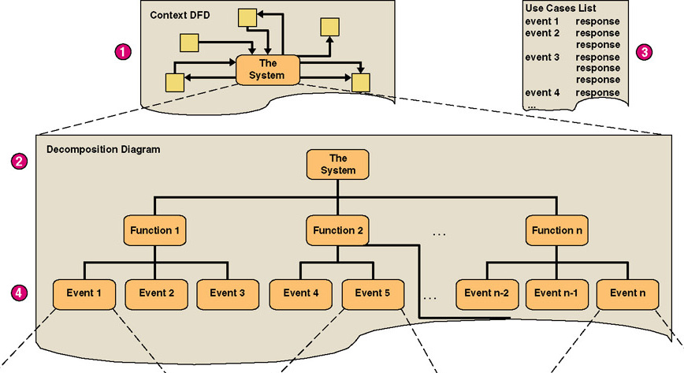
Structured Analysis
(1 of 3)
Notes:
Teaching Notes
The numbers in red correspond to the numbers on the previous slide.

Slide 7
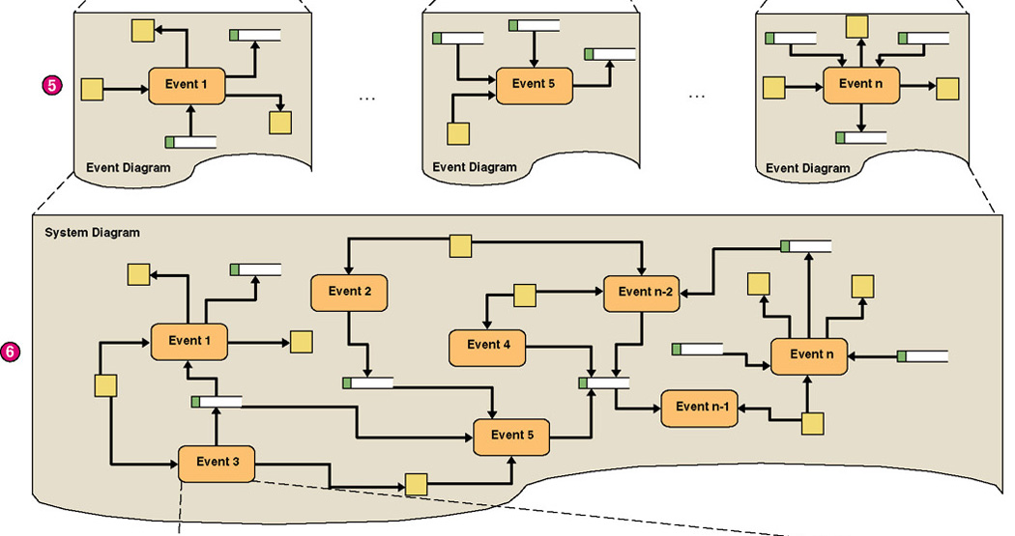
Structured Analysis
(2 of 3)
Notes:
Teaching Notes
The numbers in red correspond to the numbers on the slide 33.

Slide 8
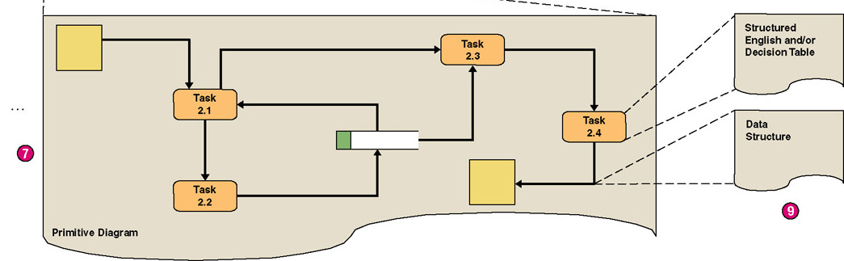
Structured Analysis
(3 of 3)
Notes:
Teaching Notes
The numbers in red correspond to the numbers on the slide 33.

Slide 9
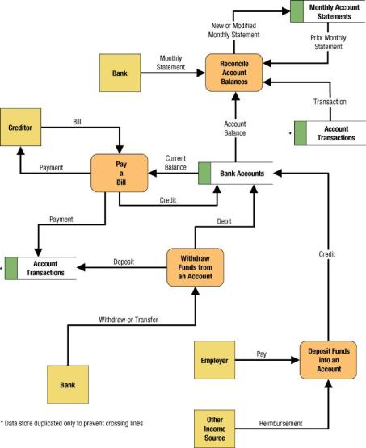
System Data Flow Diagram
Notes:
Teaching Notes
We have found it useful to walk through this first DFD. Don’t be alarmed if students take exception to some of the oversimplification of the illustrated problem—it can actually contribute to the learning experience.

Slide 10
Policies and Decision Tables
Policy – a set of rules that govern show a process is to be completed.
Decision table – a tabular form of presentation that specifies a set of conditions and their corresponding actions.
  As required to implement a policy.
Notes:
No additional notes.

Slide 11
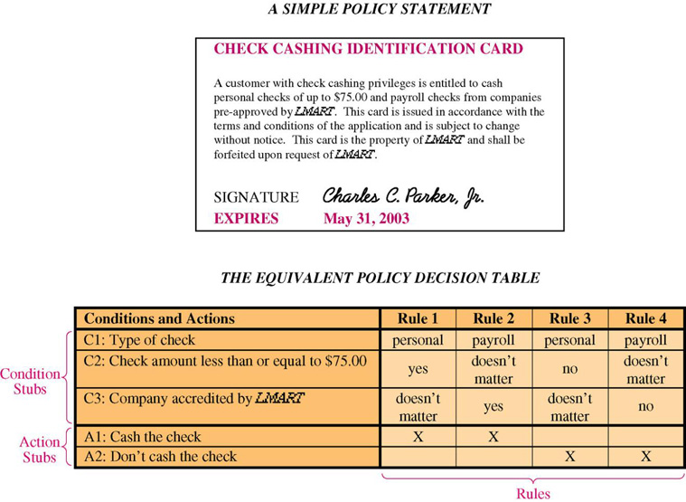
A Simple Decision Table
Notes:
No additional notes

